Slide 1

INTER-PROCEDURAL
DATA FLOW ANALYSIS
IN LLVM
USING VALUE CONTEXTS
CS738: Advanced Compiler Optimizations
Interprocedural data flow analysis in Soot using value contexts - Rohan Padhye, Uday P. Khedkar (SOAP’13)
Group 1- Deeksha Arora (20111017)
Sambhrant Maurya (20111054)
Shruti Sharma (20111061)

Slide 2

What has been implemented
A general forward intra/interprocedural framework
Currently available analyses:
Sign Analysis
Copy Constant Propagation
Problems with pass execution
Can be extended to other analyses:
Heap reference analysis
Points-to analysis
...and much more
What have you implemented?

Slide 3

Flow of Control
Don’t bore us with a lot of theory though!
Introduction
Project Objective
The Approach
Implementation
Algorithm
Sign Analysis: An example
Files in our Framework
Workflow
Demo
Test Results for Sign Analysis
Future Work

Slide 4
Introduction - What is IPA?
Interprocedural analysis spans across procedures and incorporates the effects of procedure calls in the caller procedures and calling contexts in the callee procedures.
Two approaches
Functional - Construct summary flow functions for each procedure.
Graph Reachability : special case
Call-Strings - Remember unfinished calls as strings of procedure names.

Slide 5
How Precise?
Only valid paths should be covered.
01
Flow sensitivity
Whether or not an analysis takes order of code into account.
Considers intraprocedurally valid paths
Context sensitivity
Considers the calling context when analyzing the target of a function call.
Considers interprocedurally valid paths
For maximum statically attainable precision , analysis must be both flow and context sensitive.
02

Slide 6

Project Objective
Implement a framework in LLVM to perform a fully context-sensitive forward IPA that uses value context, context <methodName, entryValue> for analysis.
What’s a value context?
Value Context
Use data flow values as context of analysis ( to avoid reanalysis of procedure bodies ). entryValue is the dataflow value at entry of procedure.

Slide 7
Value Context
X = 〈method, entryValue〉
exitValue(X)
Data Flow Analysis is performed using traditional work-list method
Work-list contains 〈context, node〉 pairs
Call-sites: Find value context X = 〈method, entryValue〉
Found: Re-use exitValue(X)
Not found: Create new X and add all nodes to work-list
Record transition from this call-site to X
Exit-sites: Set exitValue(X) and add callers to work-list

Slide 8
Value Context (continued)
Context<M,N,A>: A value-based context for a context-sensitive inter-procedural data flow analysis.
Type Parameters:
M - the type of a method
N - the type of a node in the CFG
A - the type of a data flow value

Slide 9
Assumptions
Lattice should be finite.
Flow functions are monotonic.
Lattice may or may not be distributive.

Slide 10

The Approach
Tabulation method of functional approach- Enumeration of functions as <input, output> pairs.
Value based termination of call-strings approach - Use data flow values to restrict the explosion of call strings.
If two or more calls to a procedure P have same dataflow value at entry of P , then all calls will have same value at exit of P.
So your framework utilizes best of both worlds? Nice!

Slide 11

Implementation
Finally!

Slide 12
Global Data Structures
map <M, List<Context>> contexts: set of all created contexts for a method M.
Map <CallSite,map <M,Context>> transitions: map from call-sites to contexts, parameterised by the called method M.
list <pair<Context,list<<N>>> worklist: CFG nodes parameterized with contexts that still need to be processed.

Slide 13
Algorithm
-procedure INITCONTEXT(X):
-ADD(contexts,X)
- Set ExitValue(X) <- T
- for all nodes n in the body of METHOD(X) do:
- ADD(worklist, <X, n>)
- Set IN(X, n) <- T and OUT(X, n) <- T
- Set IN(X, ENTRYNODE(m)) <- ENTRYVALUE(X)
-procedure DOANALYSIS:
- INITCONTEXT(<main,BI>)
- while ! worklist. empty() do:
- <X, n> <- REMOVENEXT(worklist)

Slide 14
Algorithm (Contd.)
- if n is not the entry node then:
- IN(n) <- ⊓_{p∈pred(n)}OUT(p)
- a <- IN(X, n)
- if n contains a method call then:
- m <- TARGETMETHOD(n)
- x <- CALLENTRYFLOWFUNCTION(X, m,n, a)
- X’ <- <m, x>
- Add transition (X’ <- <X, n>)
-if X’ ∈ contexts:
- y <- EXITVALUE(X’)
- b1 <- CALLEXITFLOWFUNCTION(X, m, n, y)

Slide 15
Algorithm (Contd.)
- b2 <- CALLLOCALFLOWFUNCTION(X, n, a)
- OUT(X, n) <- b1 ⊓ b2
-else:
-INITCONTEXT(X’)
-else:
- OUT(X, n) <- NORMALFLOWFUNCTION(X, n, a)
- if OUT(X, n) has changed :
- add succ(n) to worklist[X]
- if n is the exit node then:
- EXITVALUE(X) <- OUT(X, n)
- ADD(worklist, <X’, c>) ∀ <X’ , c> ∈ transition[X]

Slide 16
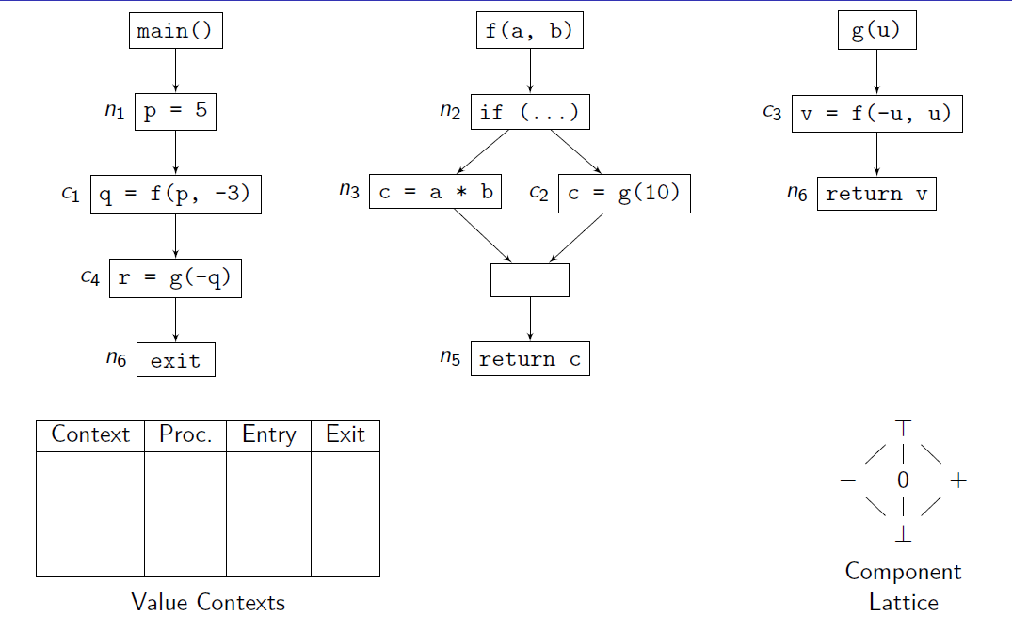
Sign analysis : An example

Slide 17
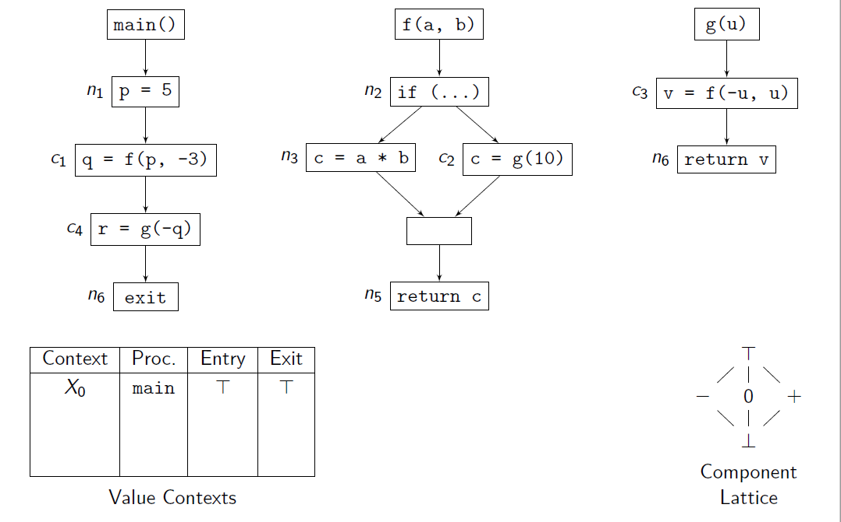

Slide 18
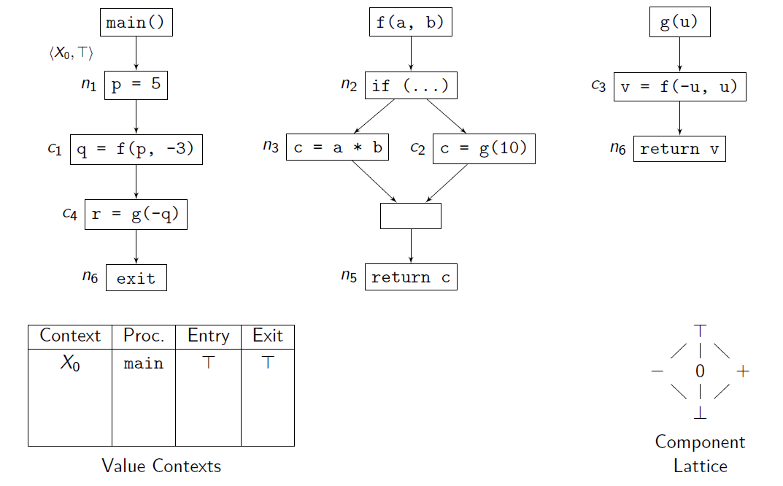

Slide 19
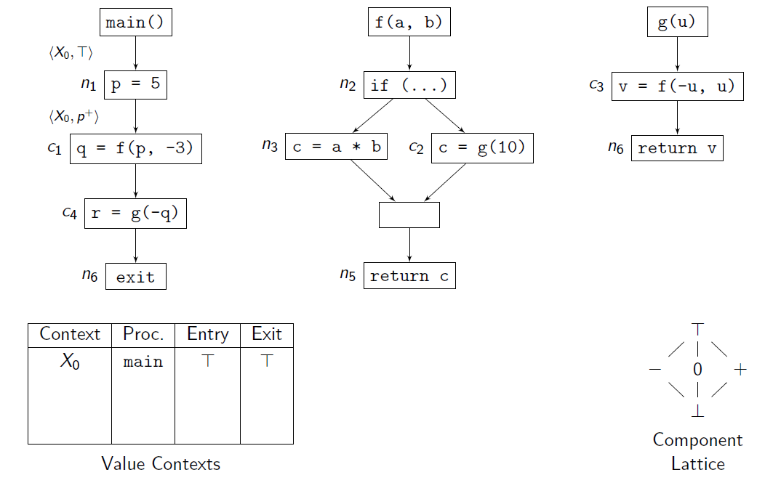

Slide 20
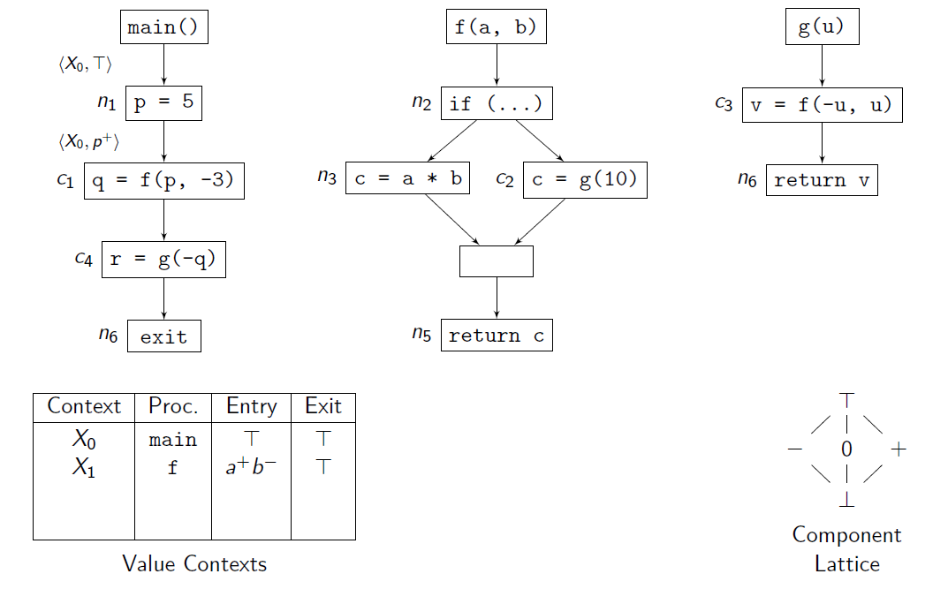

Slide 21
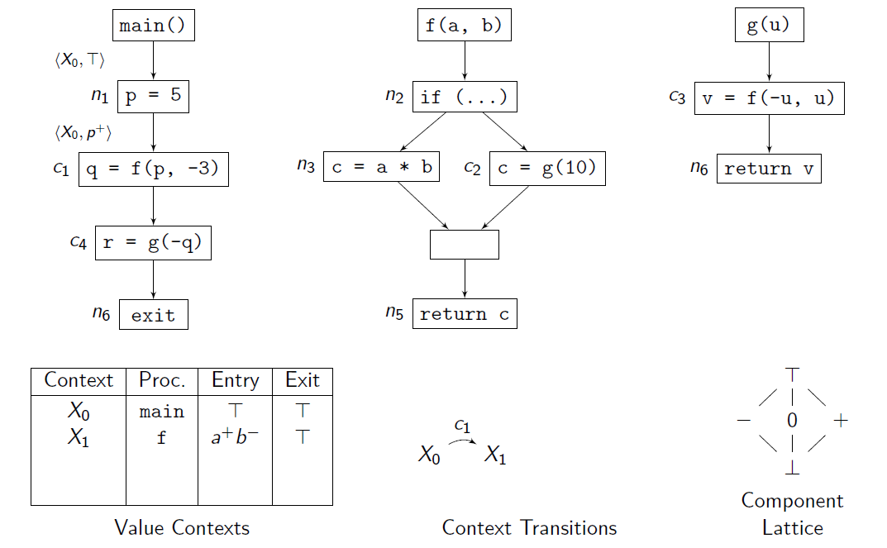

Slide 22
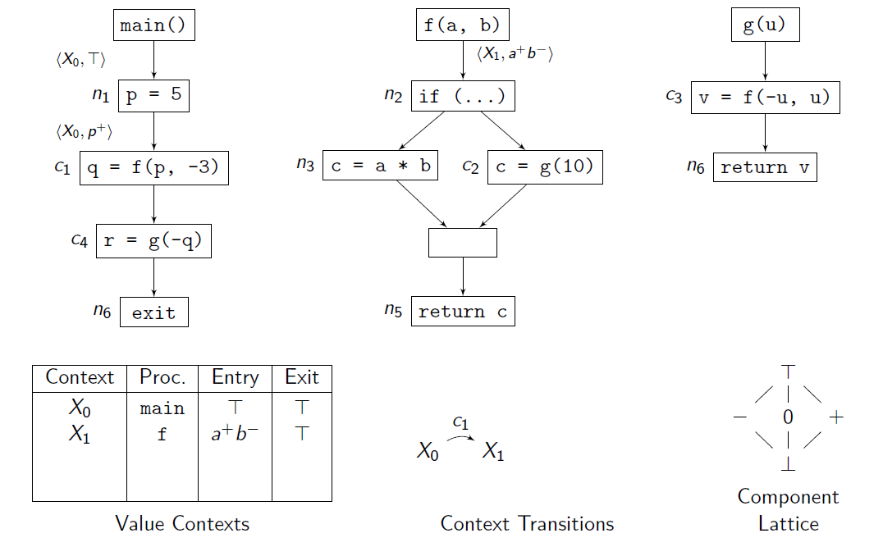

Slide 23
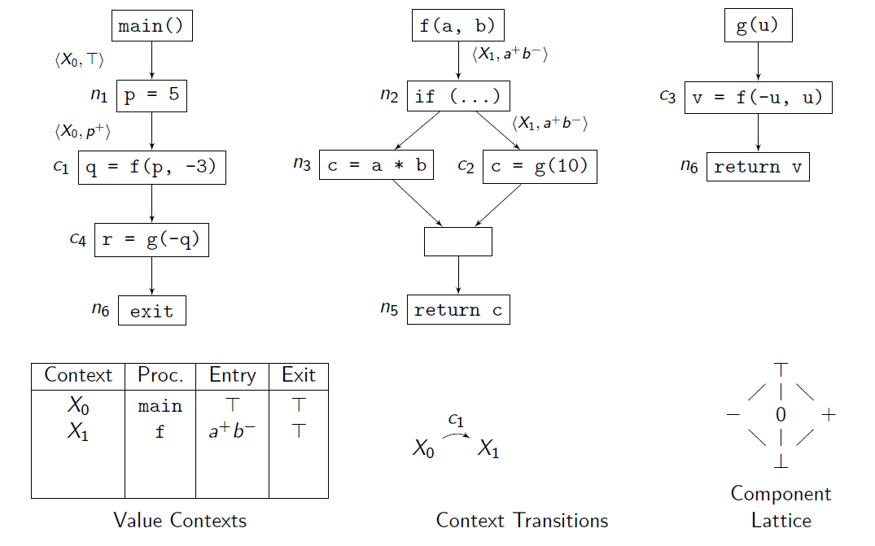

Slide 24
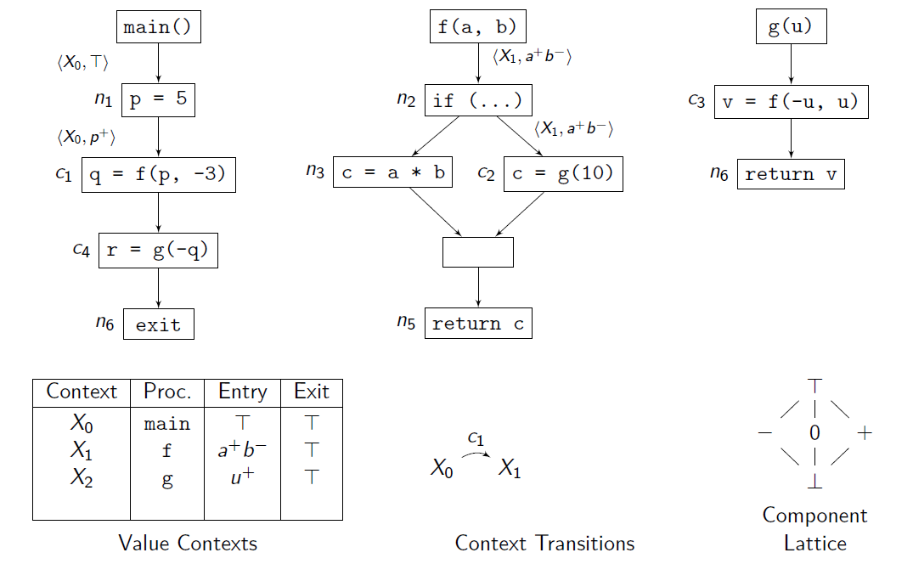

Slide 25
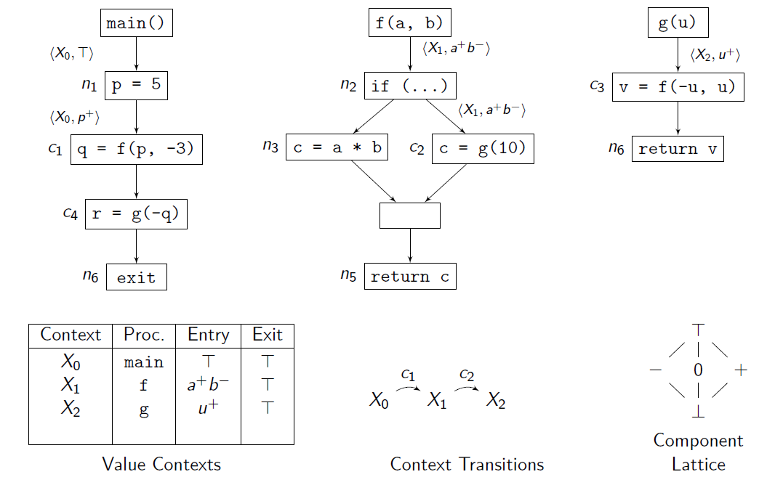

Slide 26
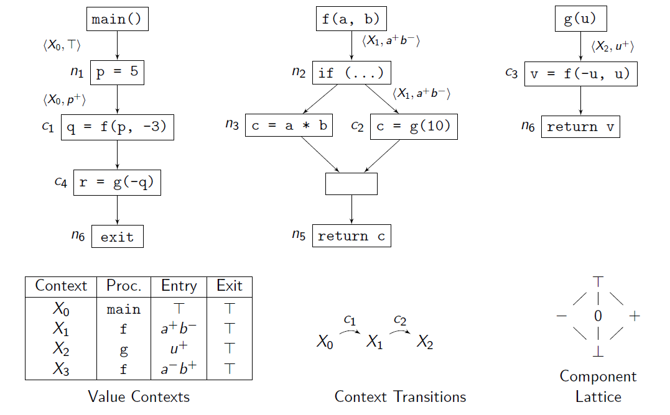

Slide 27
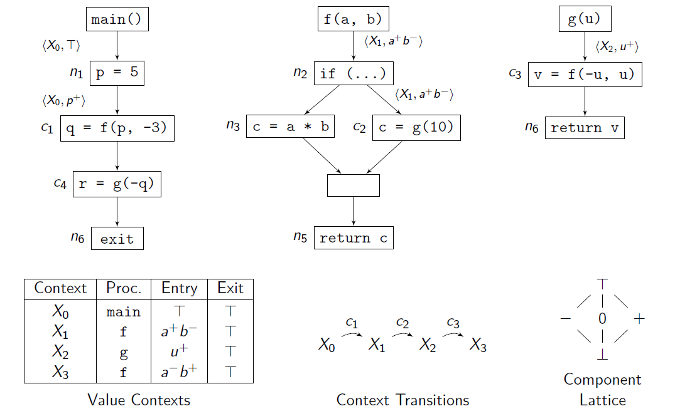

Slide 28
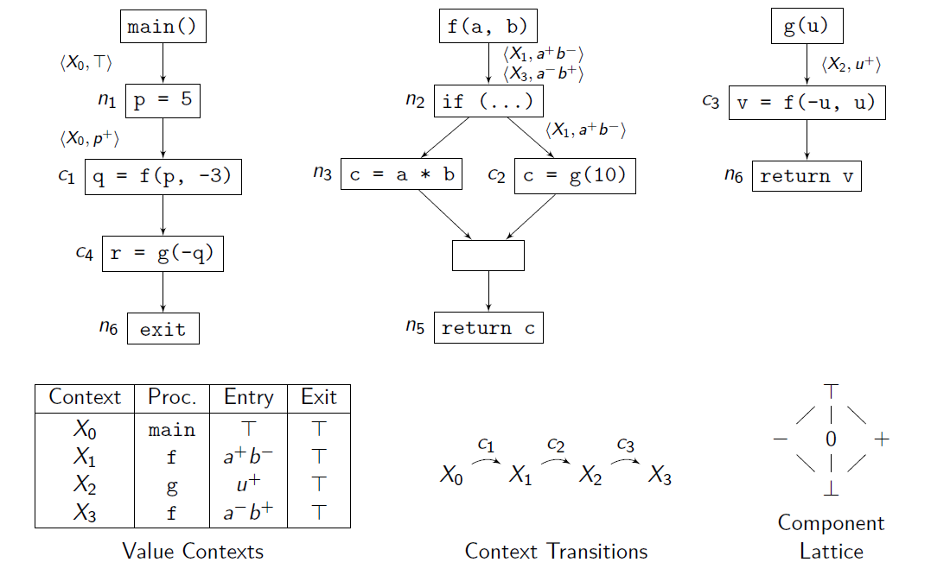

Slide 29
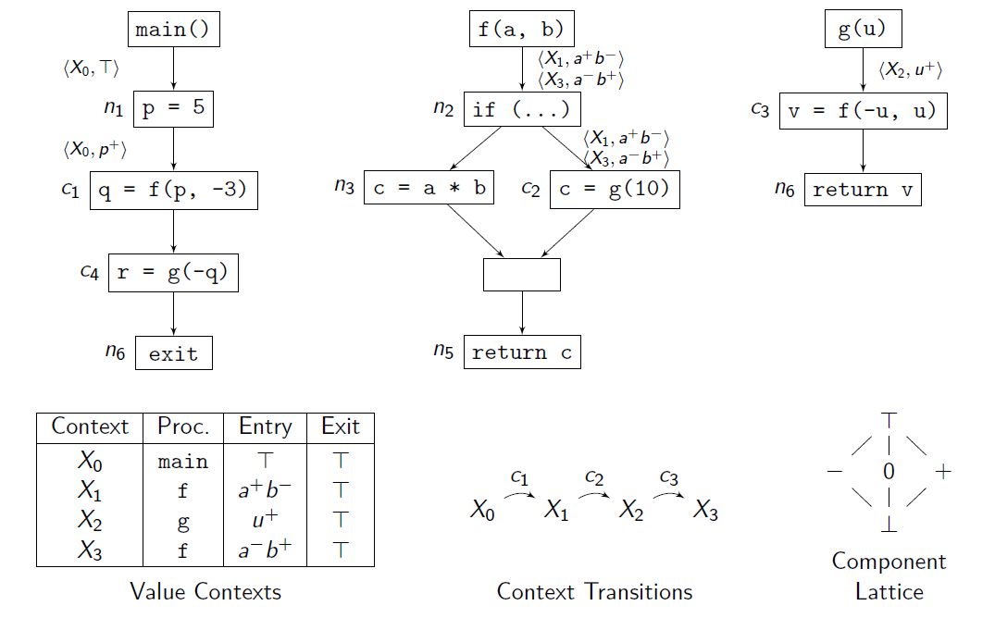

Slide 30


Slide 31
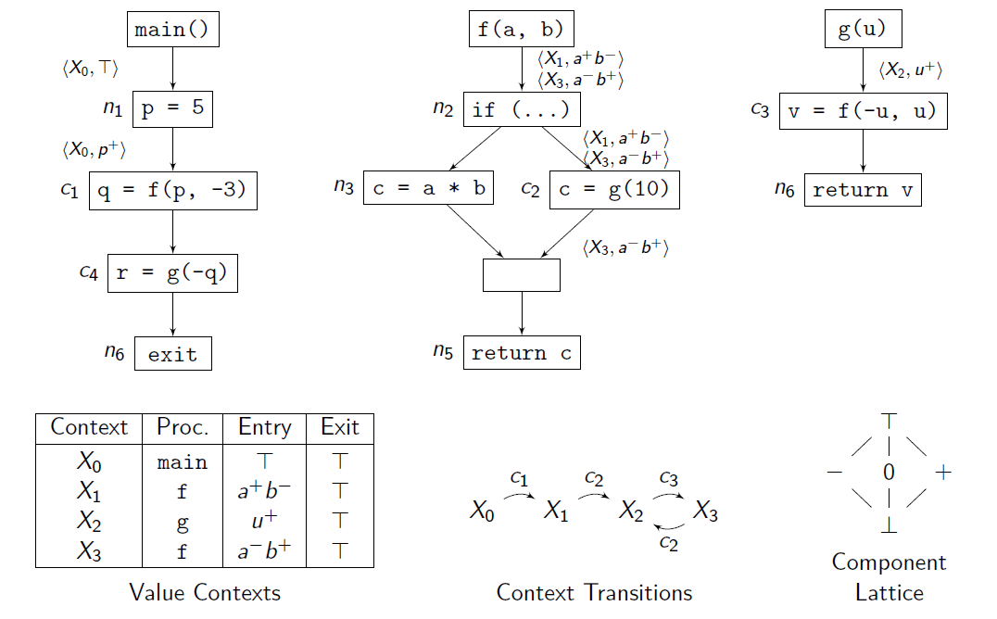

Slide 32
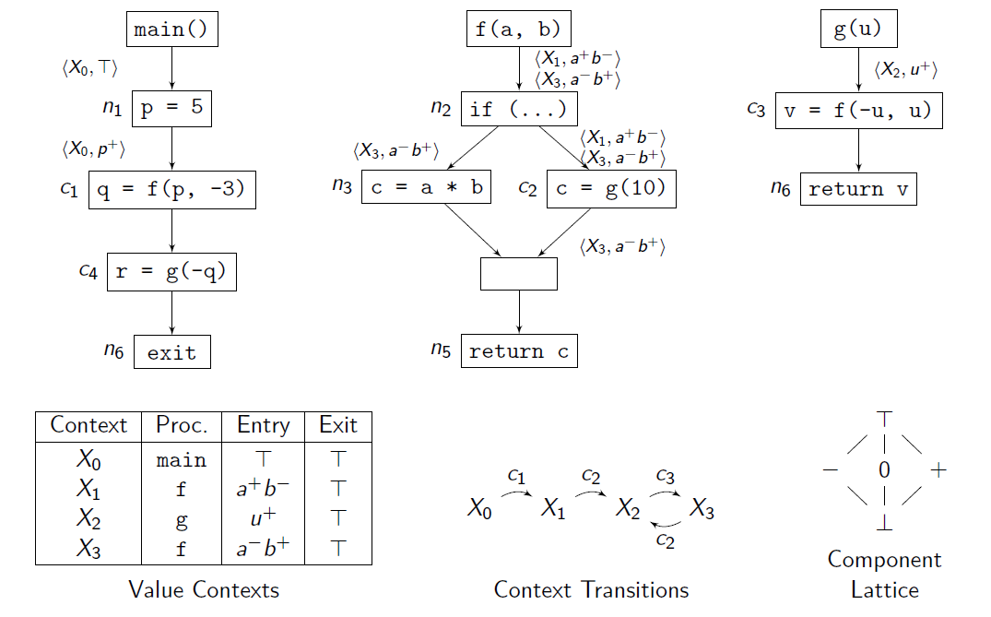

Slide 33
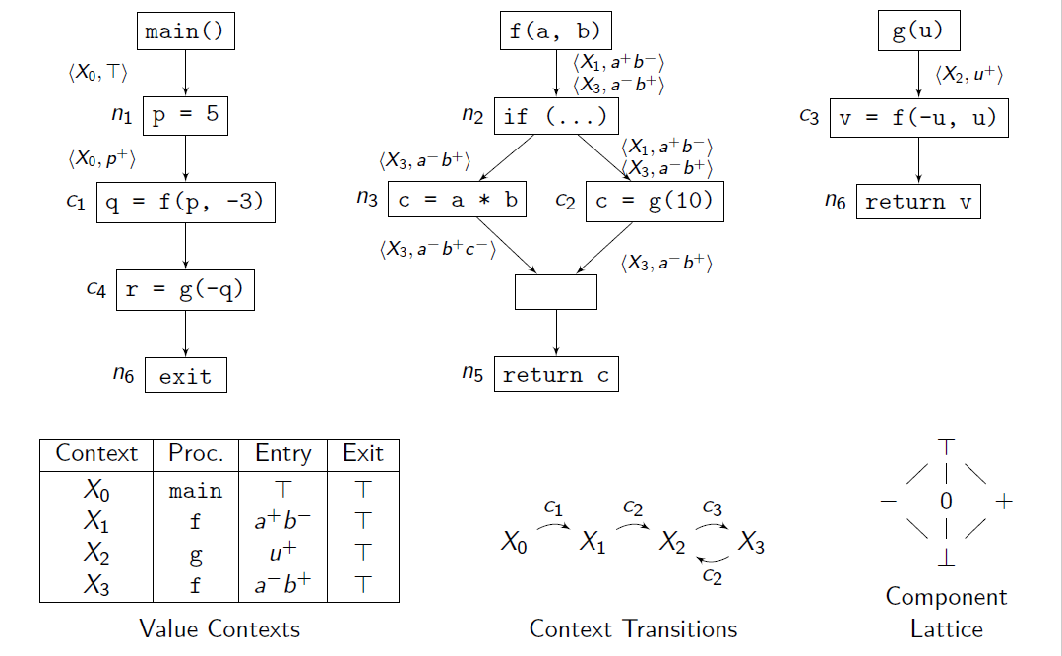

Slide 34
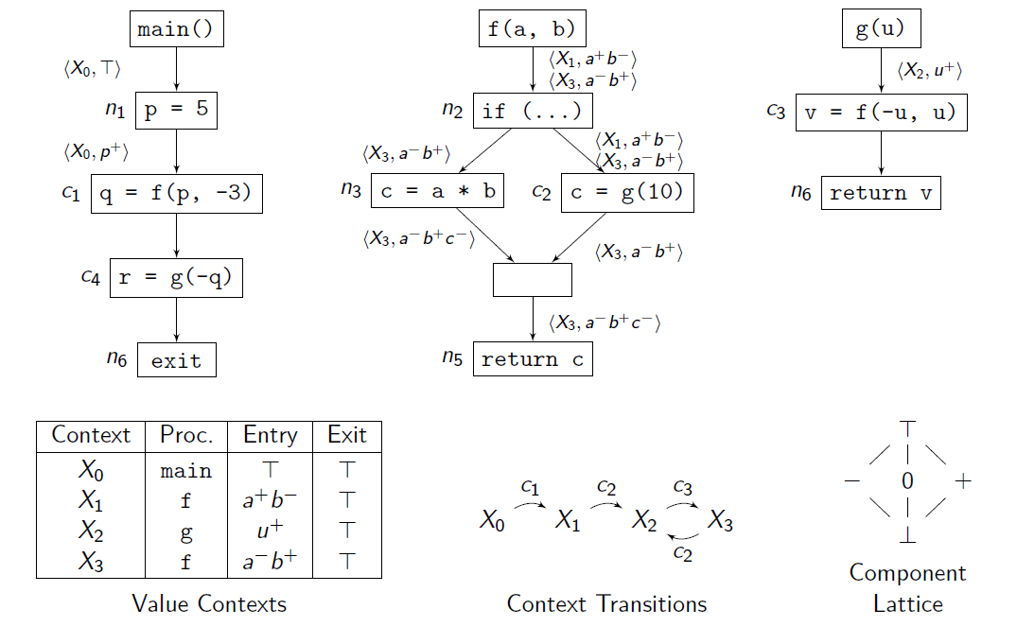

Slide 35


Slide 36
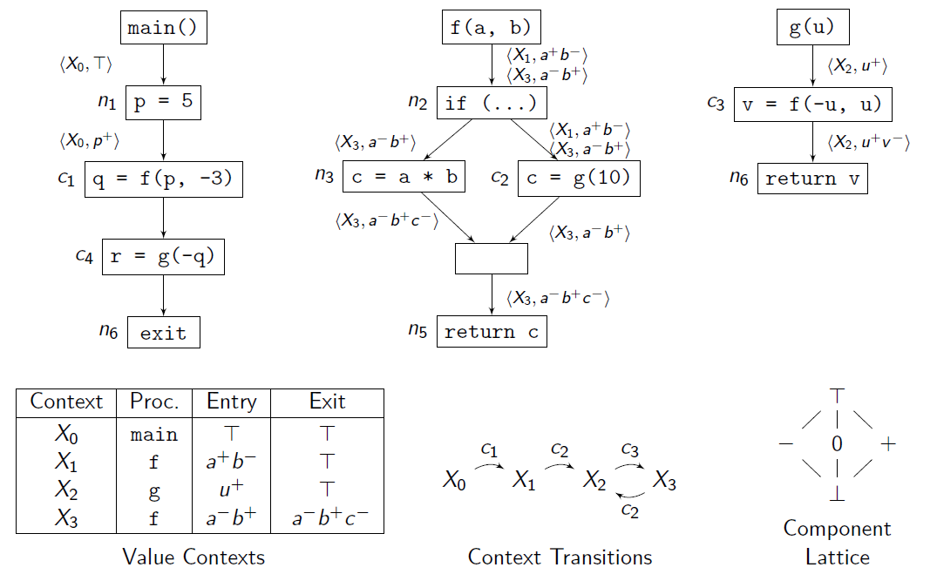

Slide 37
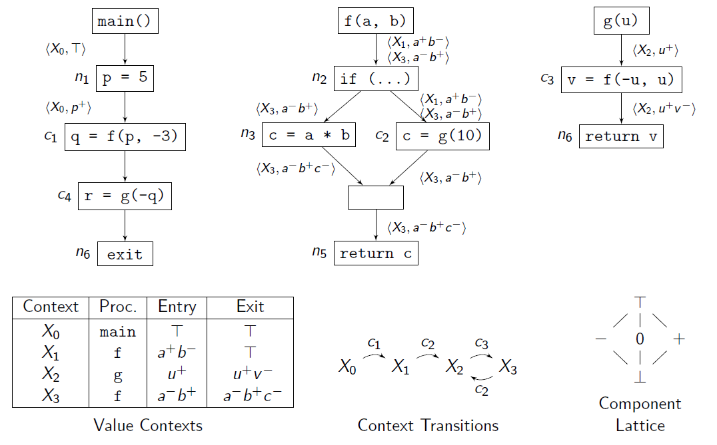

Slide 38
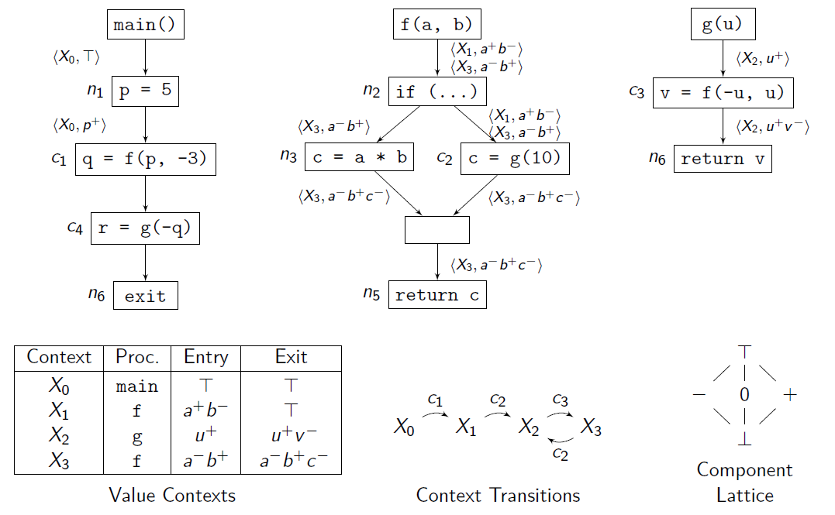

Slide 39
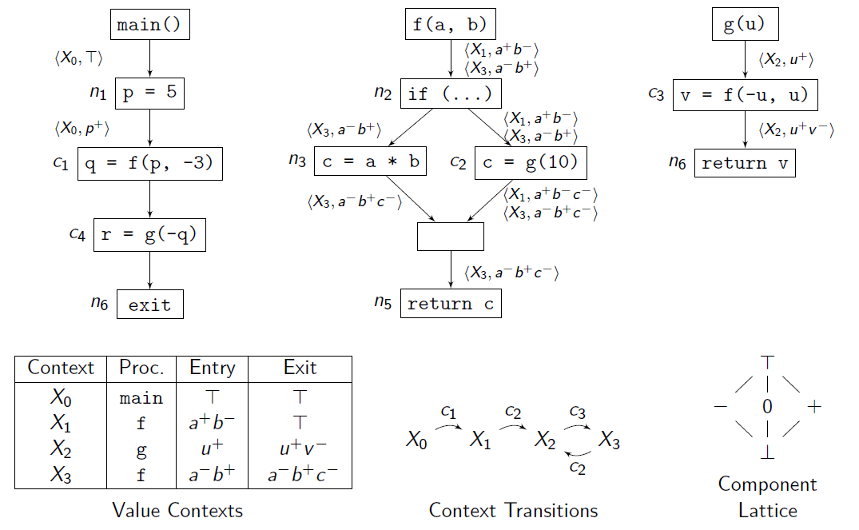

Slide 40
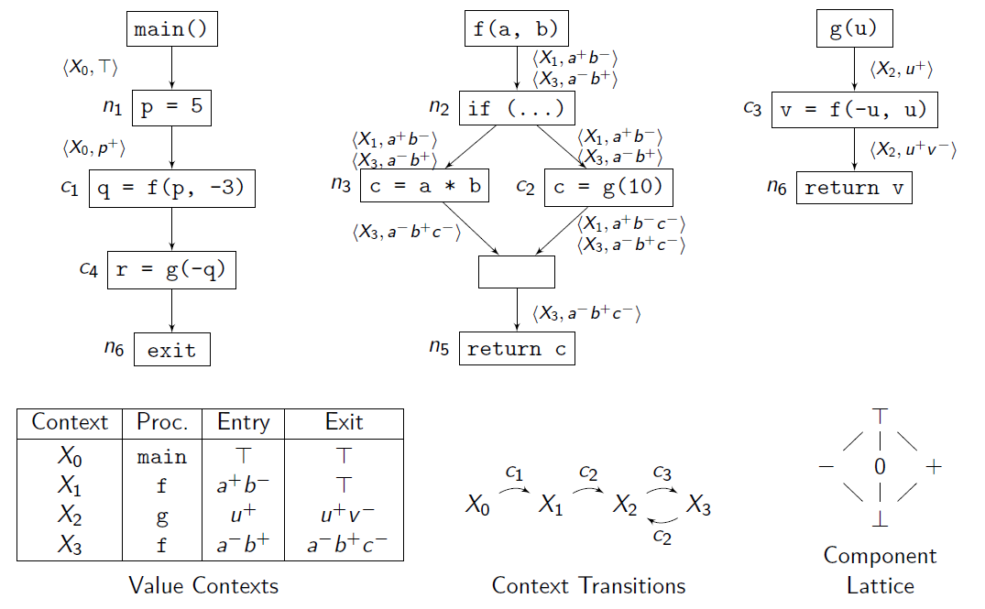

Slide 41
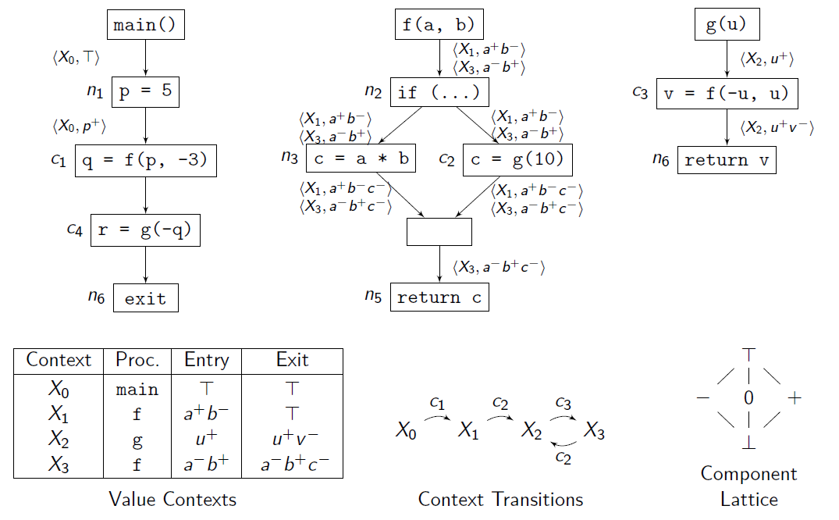

Slide 42
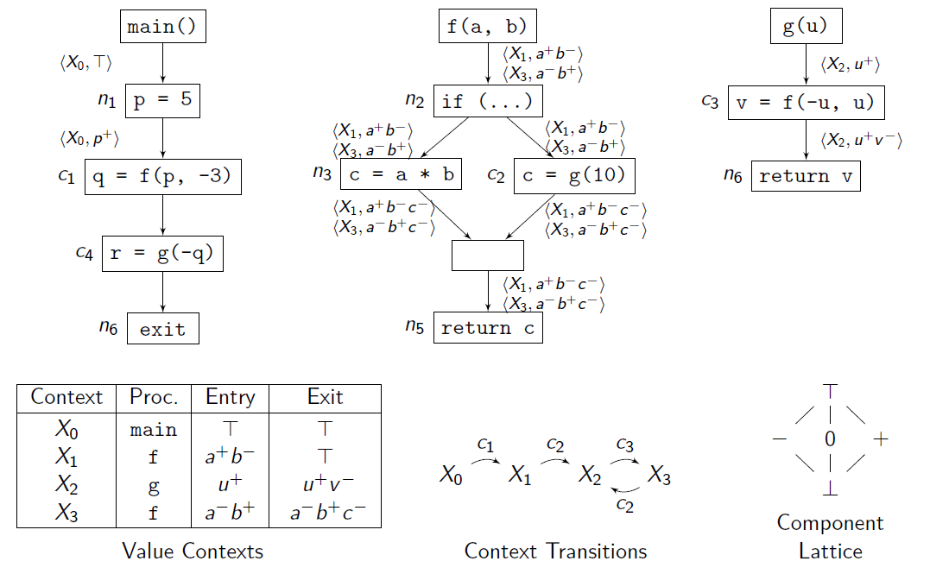

Slide 43


Slide 44
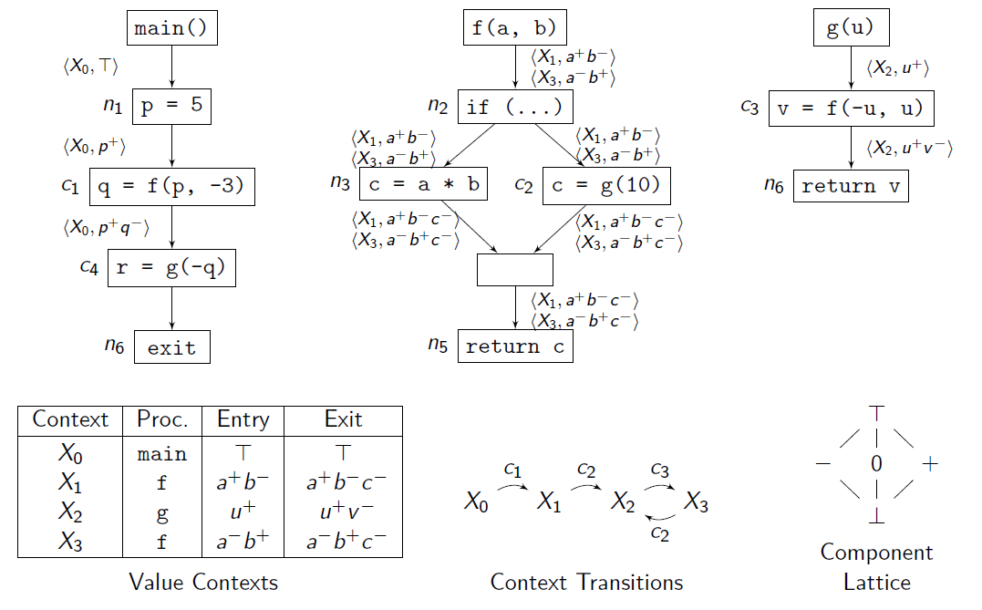

Slide 45


Slide 46


Slide 47


Slide 48
Files in our framework (and what they do)
Context.cpp
ContextTransitionTable.cpp
SignAnalysis.Sign.cpp
SignAnalysis.cpp
InterproceduralAnalysis.cpp
ForwardInterproceduralAnalysis.cpp
main.cpp

Slide 49
Context.cpp
Defines a value based context Context <M,N,A>
M - the type of a method
N - the type of a node in the CFG
A - the type of a data flow value
Each value context has its own work-list of CFG nodes to analyse, and the results of analysis are stored in a map from nodes to the data flow values before/after the node.

Slide 50
ContextTransitionTable.cpp
Keeps a record of transitions between contexts at call-sites.
The context transition table records a bidirectional one-to-many mapping of call-sites to called contexts parameterised by their methods. Defines a map from call-sites to contexts, parameterised by the called method. std::unordered_map<CallSite<M, N, A>, std::unordered_map<M, Context<M, N, A>>> transitions and a map of contexts to call-sites present within their method bodies is maintained. std::unordered_map<Context<M, N, A>, std::vector<CallSite<M, N, A>>> call_sites_of_contexts
If a call-site transition is not traversed in an analysis (e.g. a call to a native method) then it is listed as a "default site" which this table also records.

Slide 51
InterProceduralAnalysis.cpp
A generic inter-procedural analysis which is fully context-sensitive.
Fully context sensitive even in the presence of recursion and uses data flow values reaching a method to distinguish contexts.
Base file for forward_interprocedural_analysis.cpp

Slide 52
ForwardInterProceduralAnalysis.cpp
This file essentially captures a forward data flow problem which can be solved using the context-sensitive inter-procedural analysis framework as described in Inter_procedural_analysis.cpp
Client analyses will extend this file in order to perform forward-flow inter-procedural analysis.

Slide 53
SignAnalysis.cpp
An inter-procedural simplified sign analysis.
Maps numeric variables to a sign (negative, positive or zero), if it is statically determined to be singular, or else bottom.
Flow functions are non-distributive for statements involving sums or products of two variables.

Slide 54
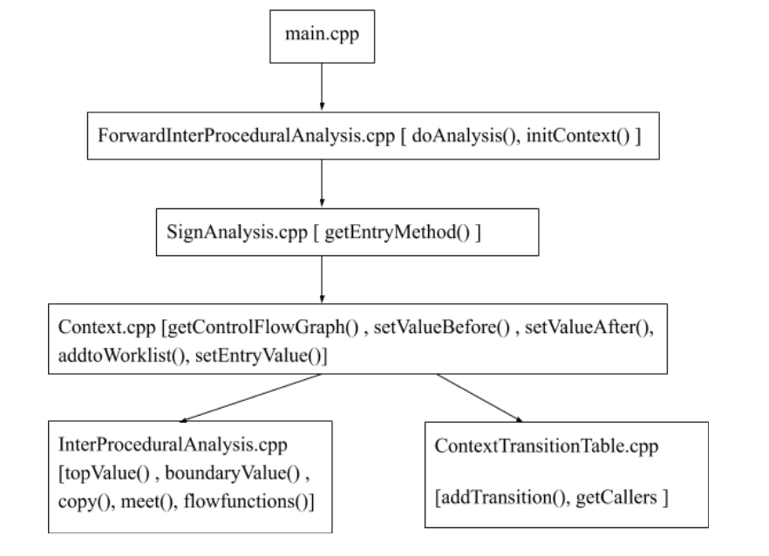
Workflow

Slide 55

Demo
Enough said! Let’s see some action!

Slide 56
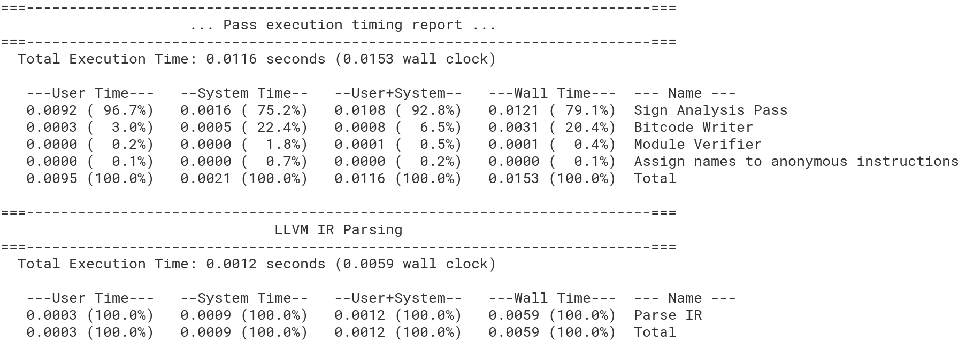
Test Results for Sign Analysis

Slide 57

Future work
Backward interprocedural analysis
Fully context-sensitive points-to analysis
Interprocedural heap analysis
Sounds like a descent idea for thesis work!

Slide 58
Thank You
(For being an amazing instructor)
We really enjoyed the course.🙂
Deeksha Arora (20111017)
Sambhrant Maurya (20111054)
Shruti Sharma (20111061)

